Slide 1
DEBUGGING JAVA PROGRAMS USING ECLIPSE DEBUGGER
SPECIAL JAVA SUBJECT

Slide 2
Overview
What is a debugging
  Debugging is the process of locating the source of programming errors (often called bugs) and correcting them
What is a debugger?
  Set of tools that let us:
      Pause a running program at any point
      Examine the contents of the variables

Slide 3
Overview
Why a debugging?:
  Debug our code (Why isn’t it working)
  Get a better understanding of Java and OOP
Required debugging skills:
  Understanding a break point
  Stepping througth a program
  Examining the contents of program variables

Slide 4
Overview
Basic debugging steps:
  Switch to the Debug Perspective
  Set one or more Breakpoint(s)
  Run the Debugger (debug as program)
  Step Over a Method Call.
  Step Into a Method.
  Step return
  Inspecting Variables.
  Debugging into Java Classes.
  Review the Method Call Stack.

Slide 5
Eclipse Debugger

Slide 6
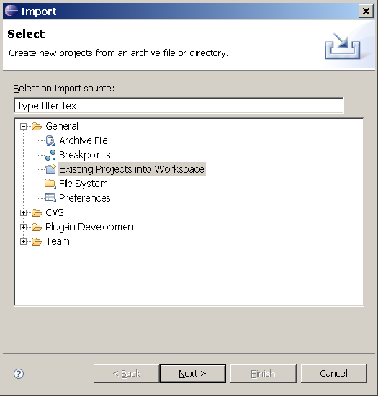
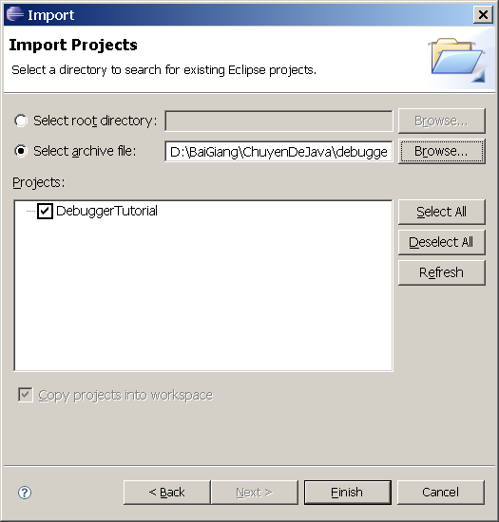
Load project from achive (.zip) file

Slide 7
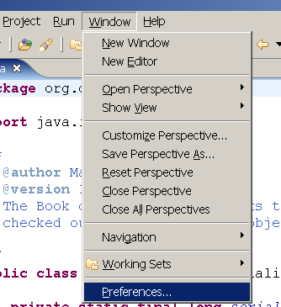
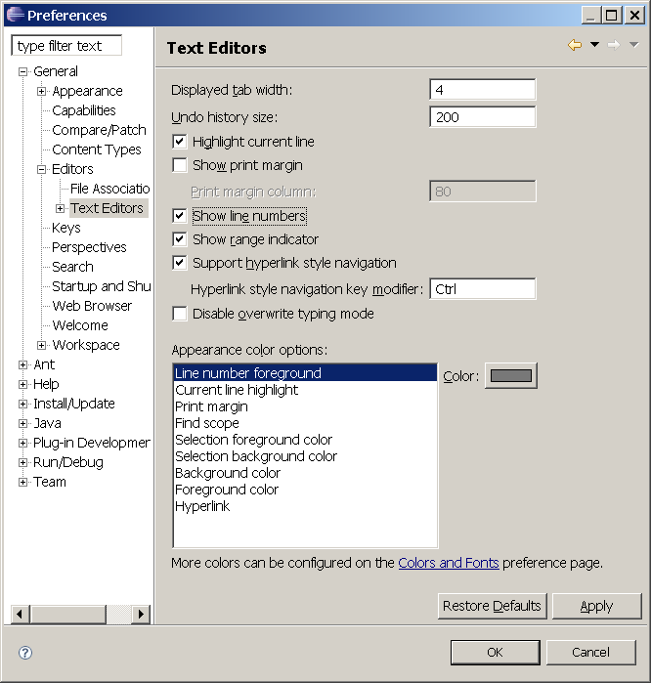
Show line numbers

Slide 8
Starting a debug session
Tell debugger where to pause
Run program in debug mode:
  Set breakPoints
  Debug as Java Application

Slide 9
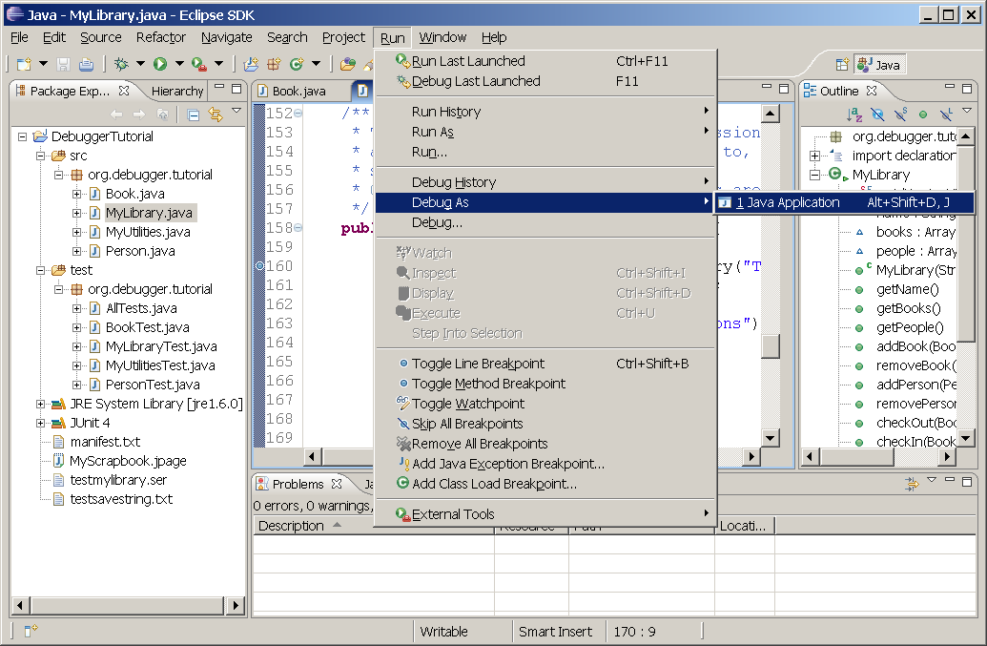
Starting a debug session
Breakpoint marker
Shaded area

Slide 10
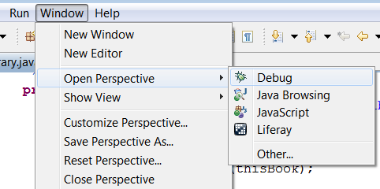
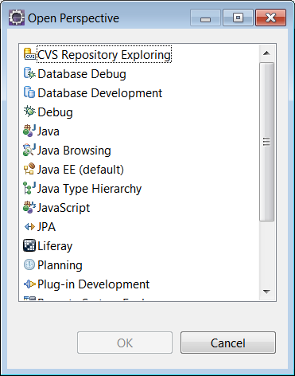
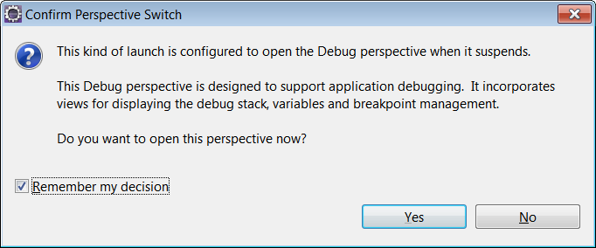
Switch to debug perspective

Slide 11
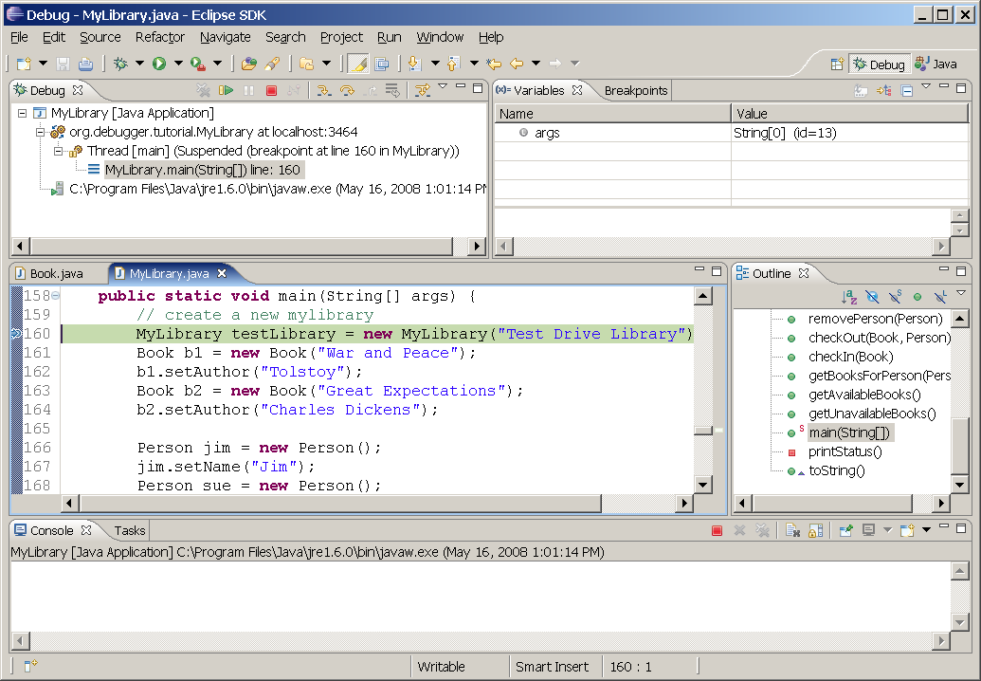
Eclipse Debug Perspective
Debug Toolbar
Debug Perspective
Variable/Breakpoint view
Debug view (panel)
Java Perspective
Editor (source) view

Slide 12
Debug ToolBar
Resume
Terminate
Step Over
Drop to Frame
Suspend
Step Into
Step Return
Step Filters
Resume : Execute the program until it ends, or until a breakpoint
Suspend: Pause an executing program; it is almost never used (except to stop an infinite loop).
Terminate: Terminate a debugging session;
Step Into: Move into the method (or constructor) and pause at the first line;
Step Over: Execute one Java statement (execute current line end stop at next line);
Step Return: Finish the current method and return to the calling method;

Slide 13
Part 1 – Basic
  Switch to the Debug Perspective
  Set one or more Breakpoint(s)
  Run the Debugger (debug as program)
  Step Over a Method Call.
  Step Into a Method.
  Step return
  Review the Method Call Stack (FILO).
  Example:
    Class: MyLibrary, Method: main
    Class: Book, Method: setAuthors

Slide 14
Part 2
Examine variable content
  Resume Button
  Run to Line (CTRL-L)
  Expression view
  Variable view
  Display view
  Console view
  Watch -> Expression
  Display (CTRL-SHIFT-D)
  Inspect (CTRL-SHIFT-I)
Example:
    Class: MyLibrary
    Method: main

Slide 15
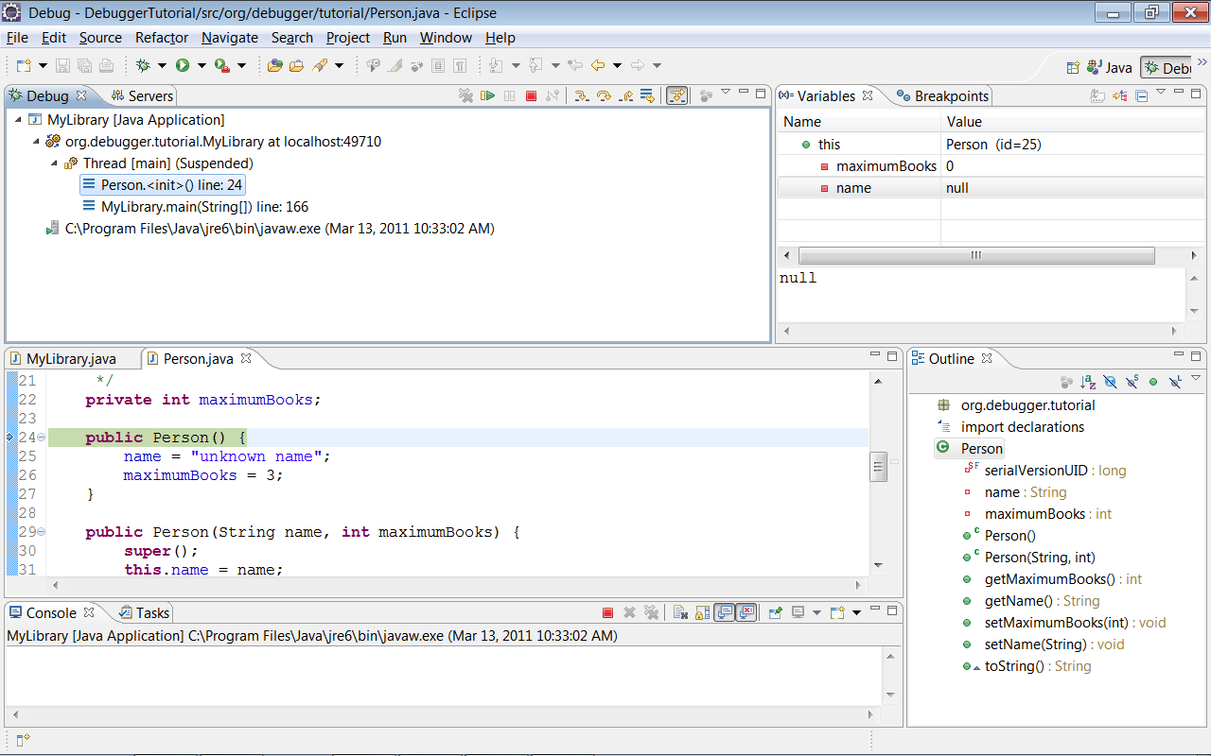
“this” variable
toString

Slide 16
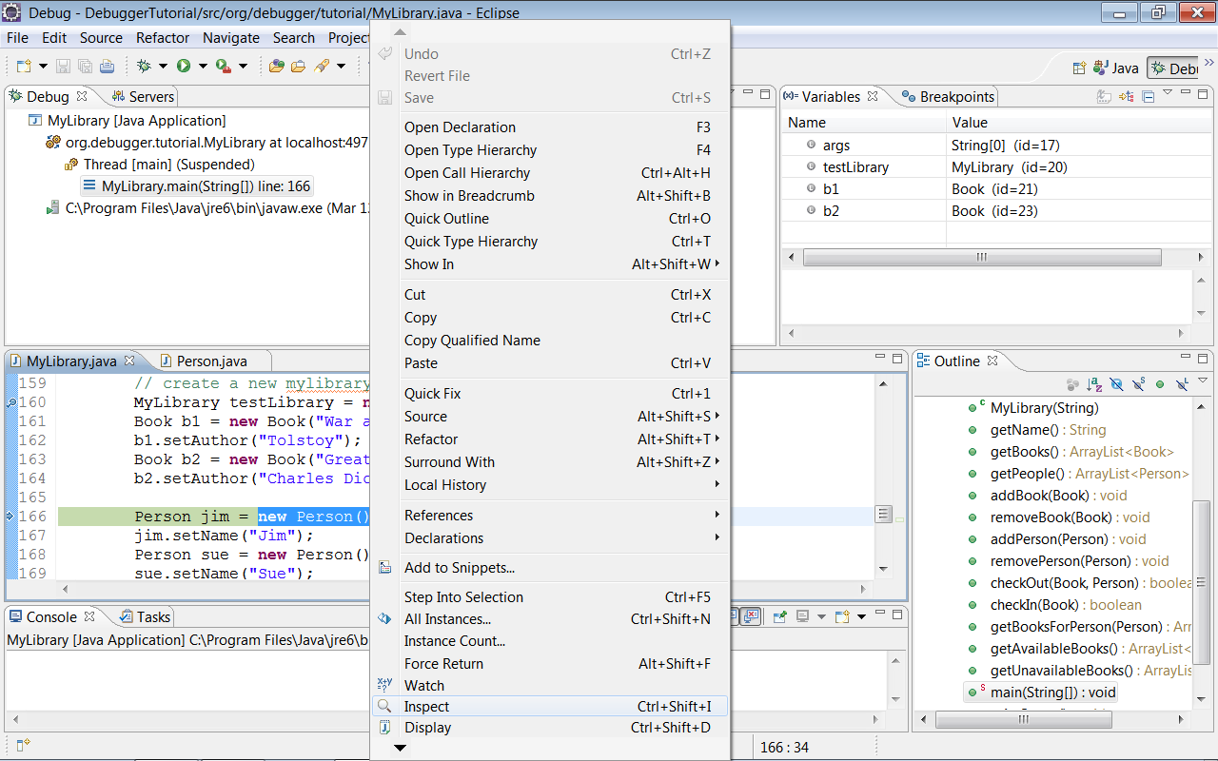
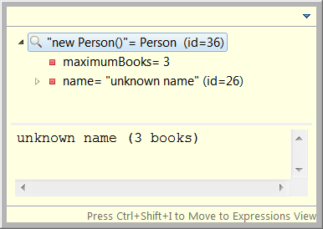
inspect

Slide 17
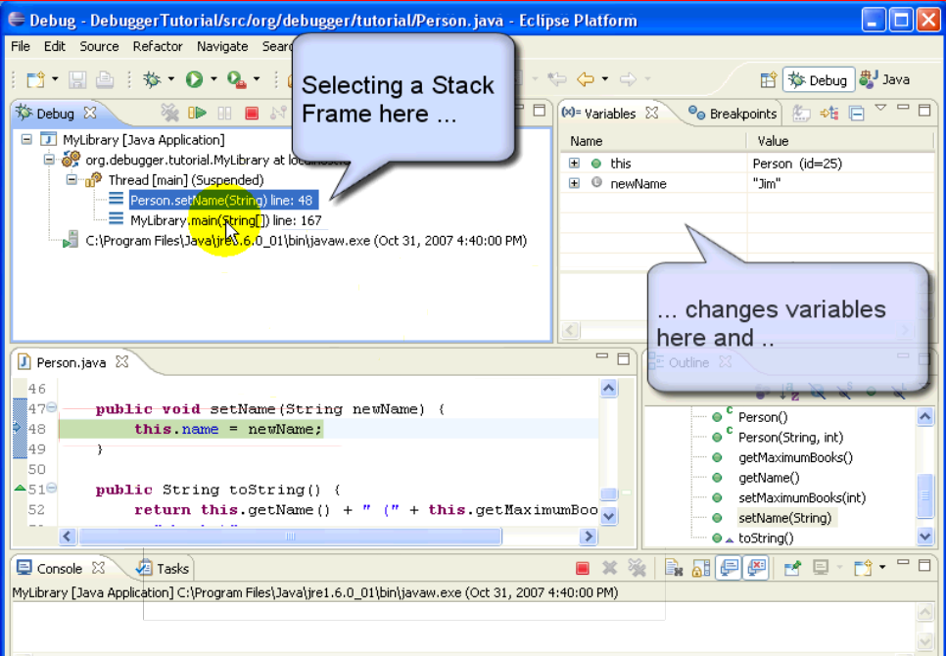
Select a stack frame

Slide 18
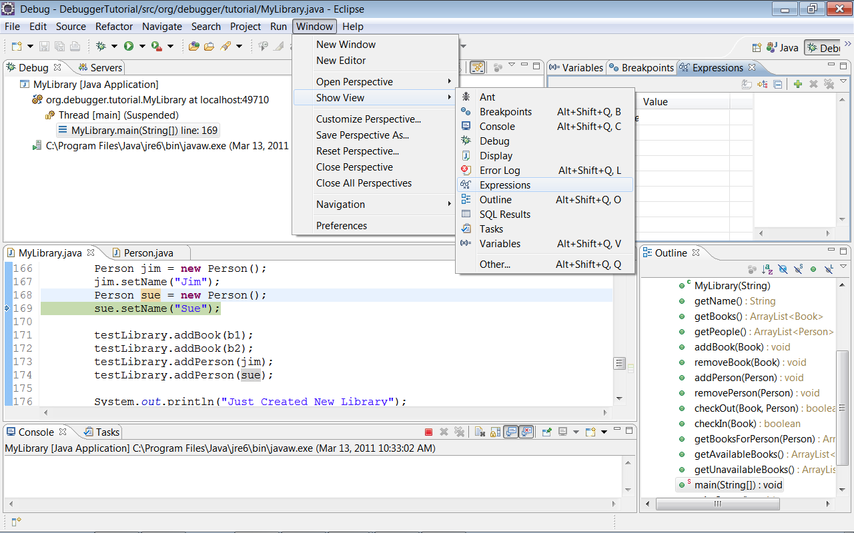
Watch Expression

Slide 19
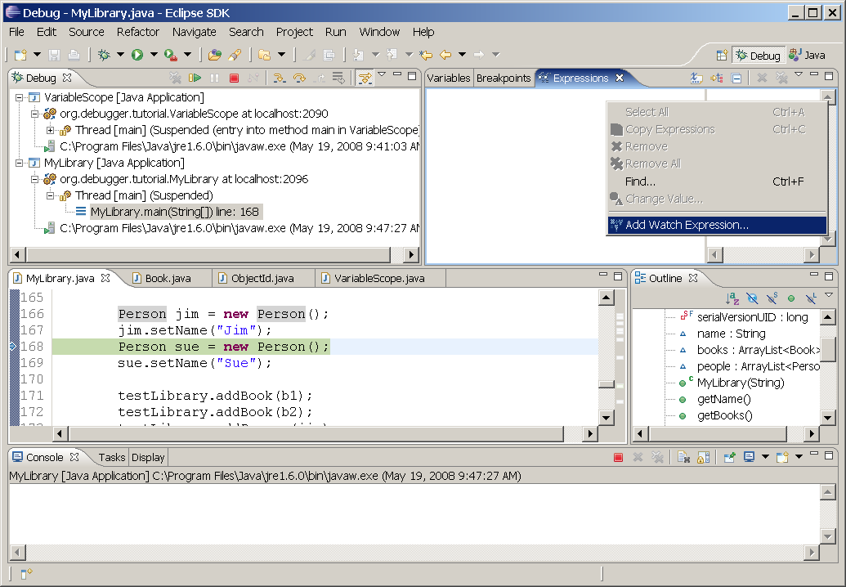
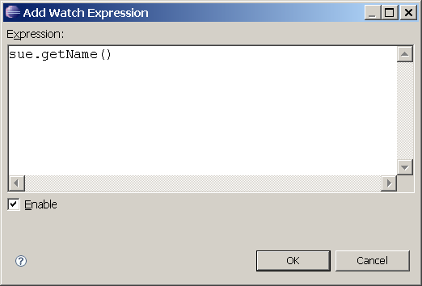
Add Watch Expression

Slide 20
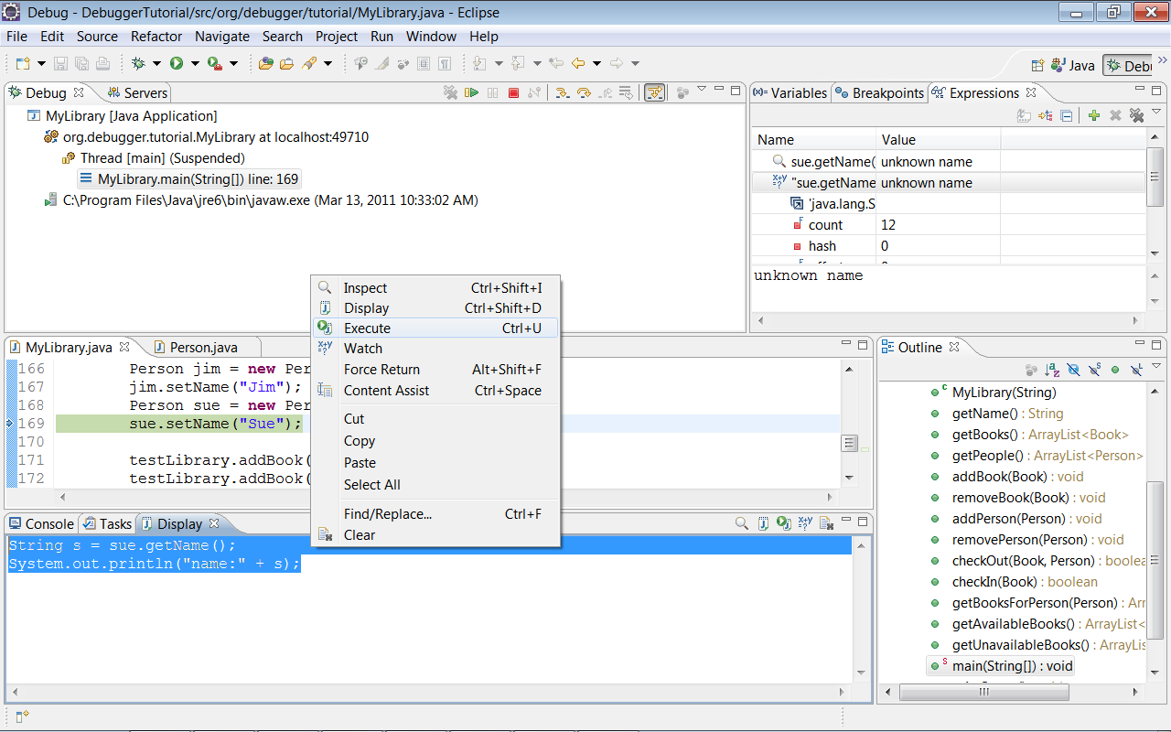
Display views

Slide 21
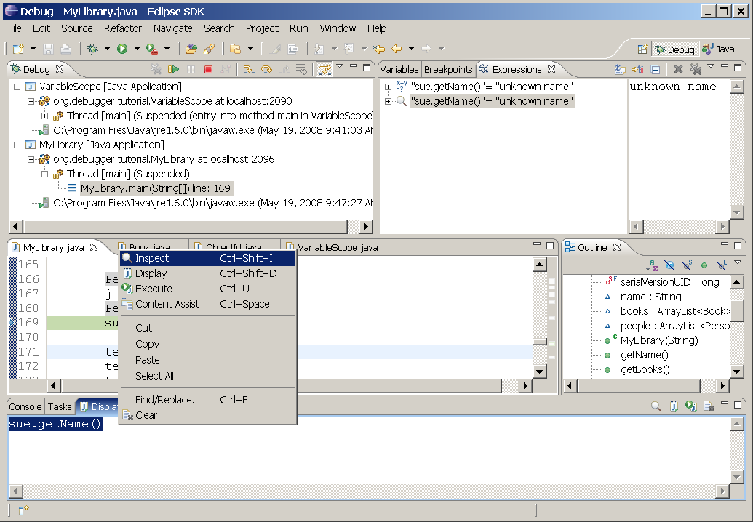
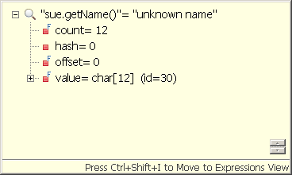
Watch and Display Views
Expression
Inspect

Slide 22
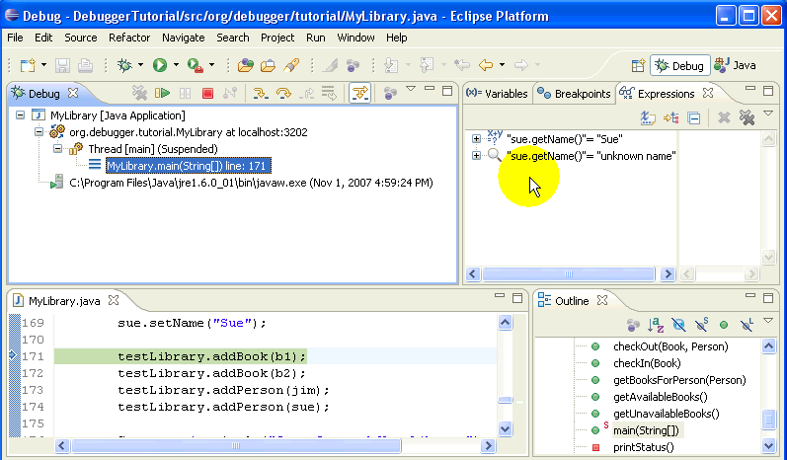
Watch and Display Views
Move from Inspect View to Expression View: Ctrl+Shift + I
Sự khác biệt cơ bản giữa expression và Inspect trong cửa sổ Expression là Inspect luôn hiển thị giá trị không đổi còn giá trị của expression thay đổi khi tiếp tục chạy chương trình

Slide 23
End of first day

Slide 24
Part 3
Debugging MyLibrary class
  Debug as JUnit Test (/test/MyLibraryTest.class)
  Method check out
Add Java Exception BreakPoint
Executing code while debugging
Adding watch expressions
Modifying code while debugging
Select Closing Element (Expression):
ALT-SHIFT-UP/DOWN

Slide 25
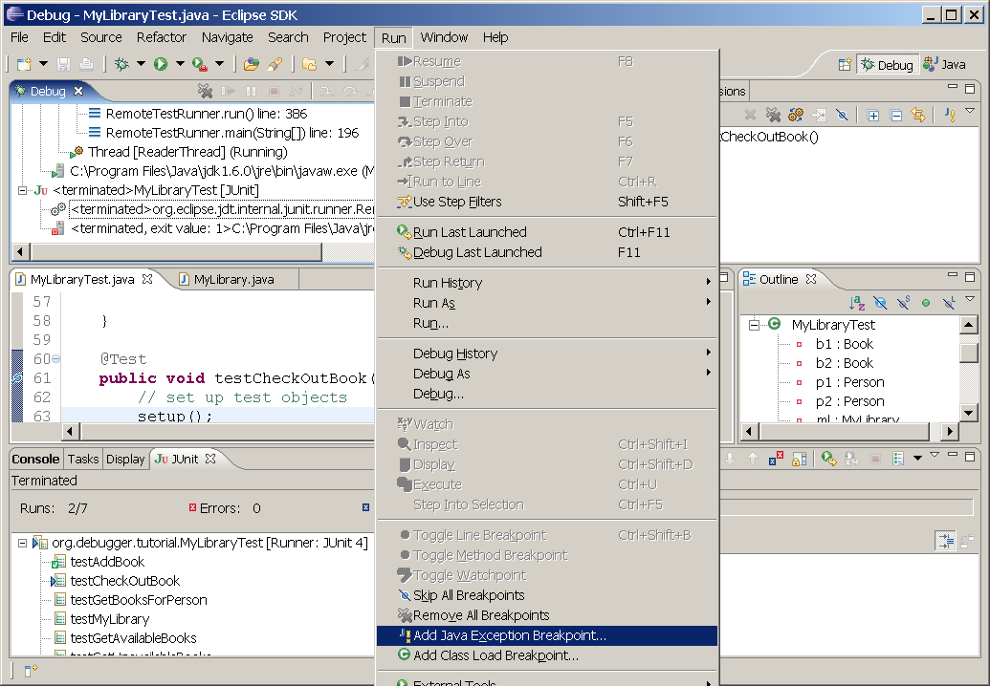
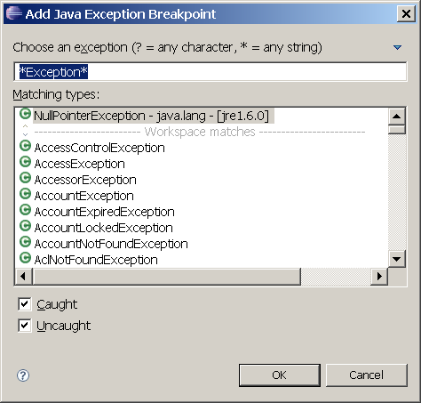
Add Java Exception BreakPoint

Slide 26
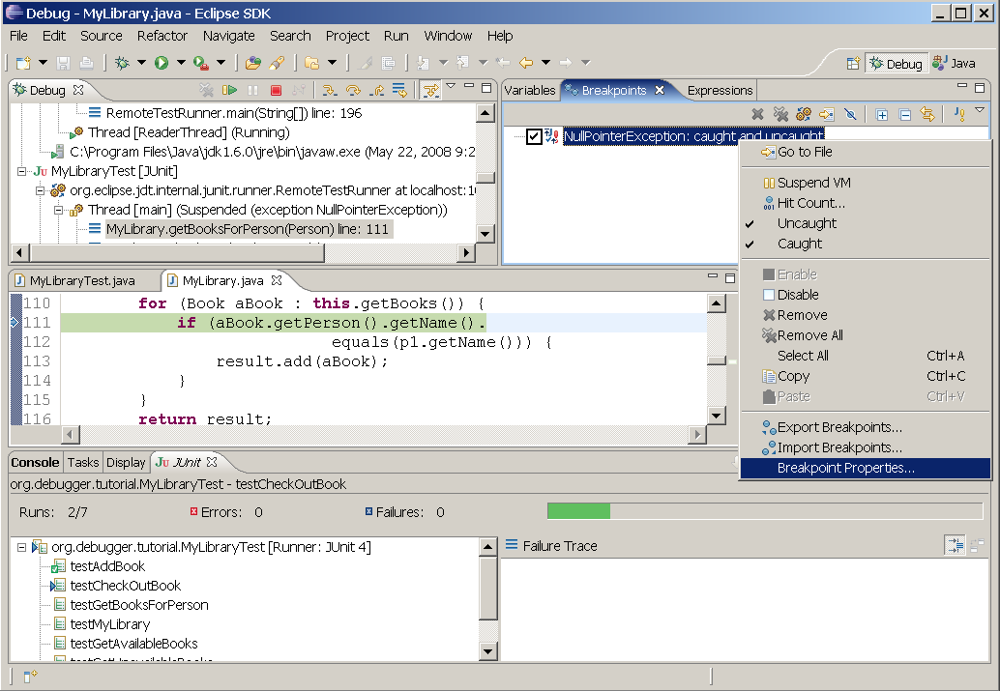
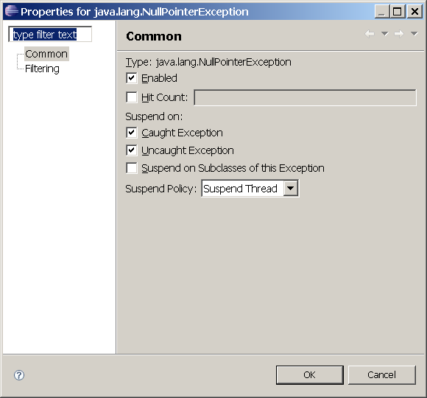
BreakPoint Properties

Slide 27
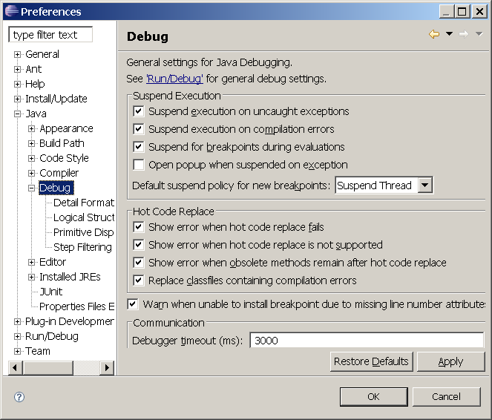
Preferences Configuration

Slide 28
Part 4
Hit counts and conditional Breakpoints
  checkIn method
Class BreakPoints and WatchPoints
Suspend command
Step into Selection

Slide 29
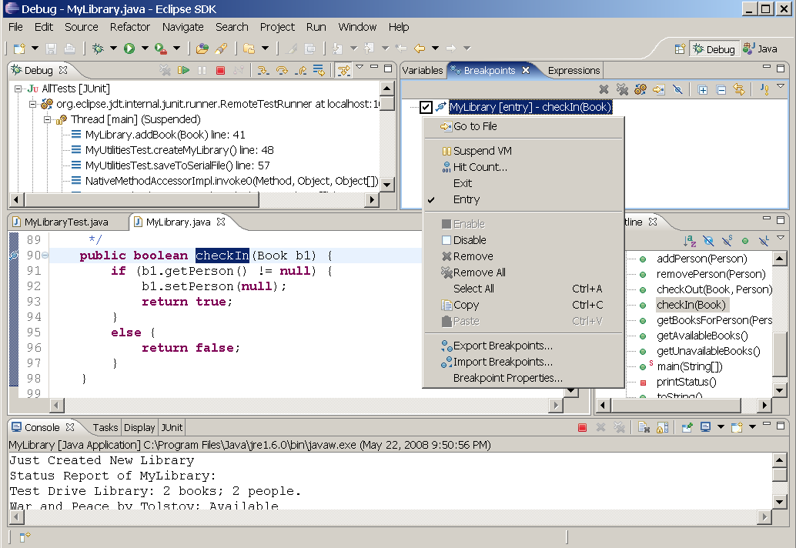
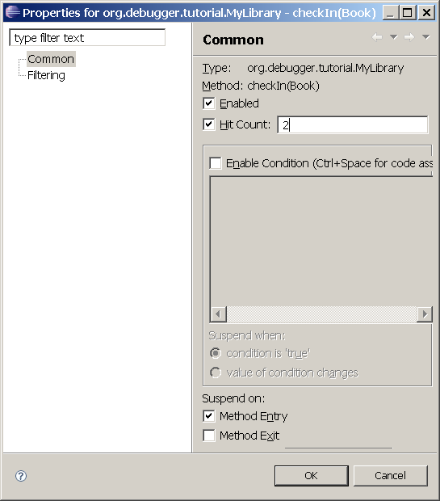
Hit counts

Slide 30
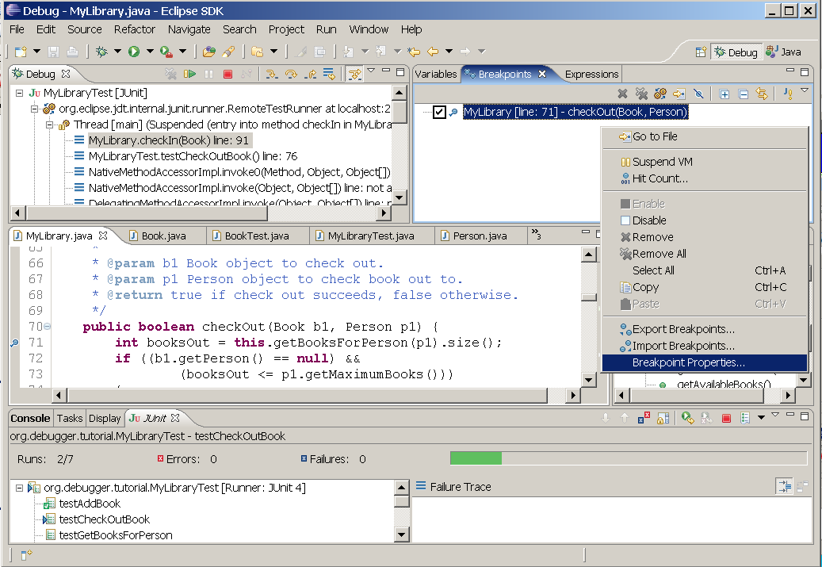
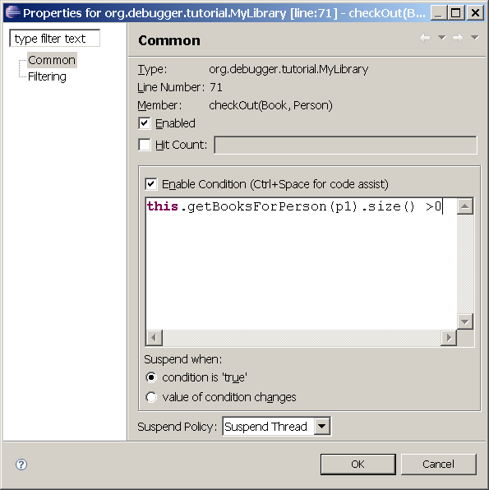
Conditional BreakPoints

Slide 31
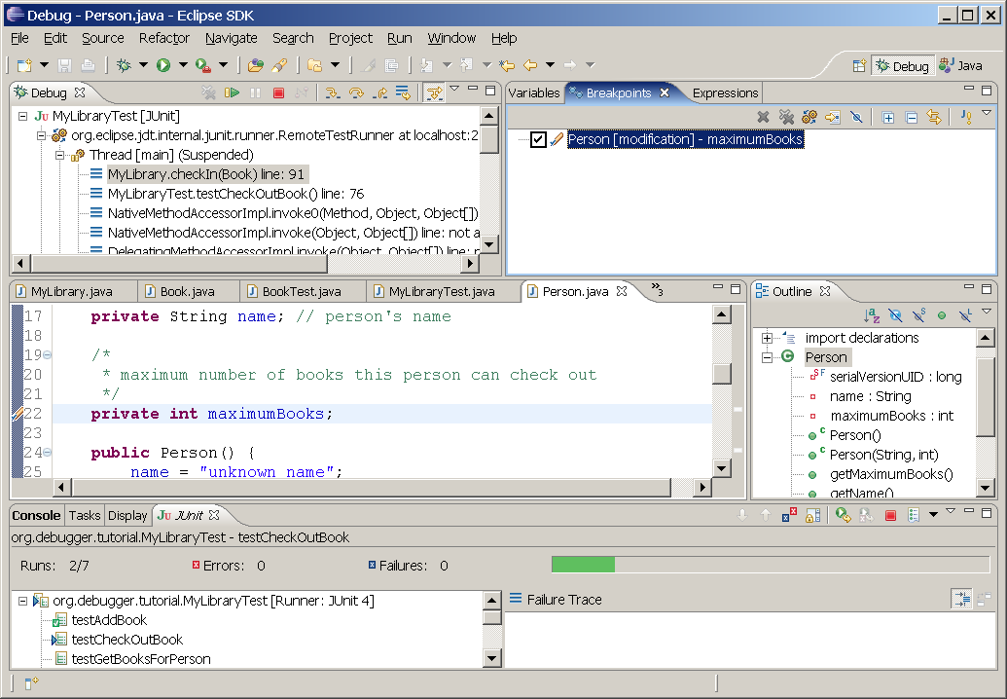
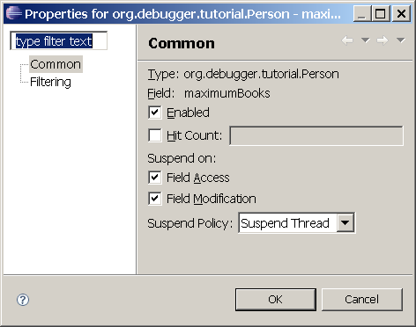
WatchPoint

Slide 32
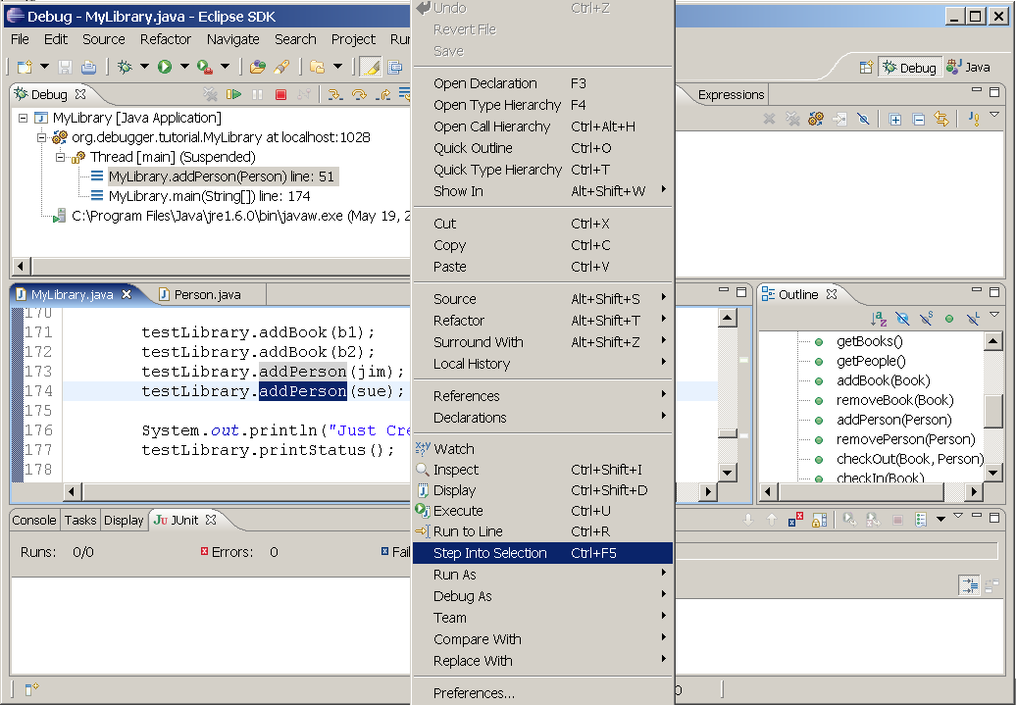
Step into Selection

Slide 33
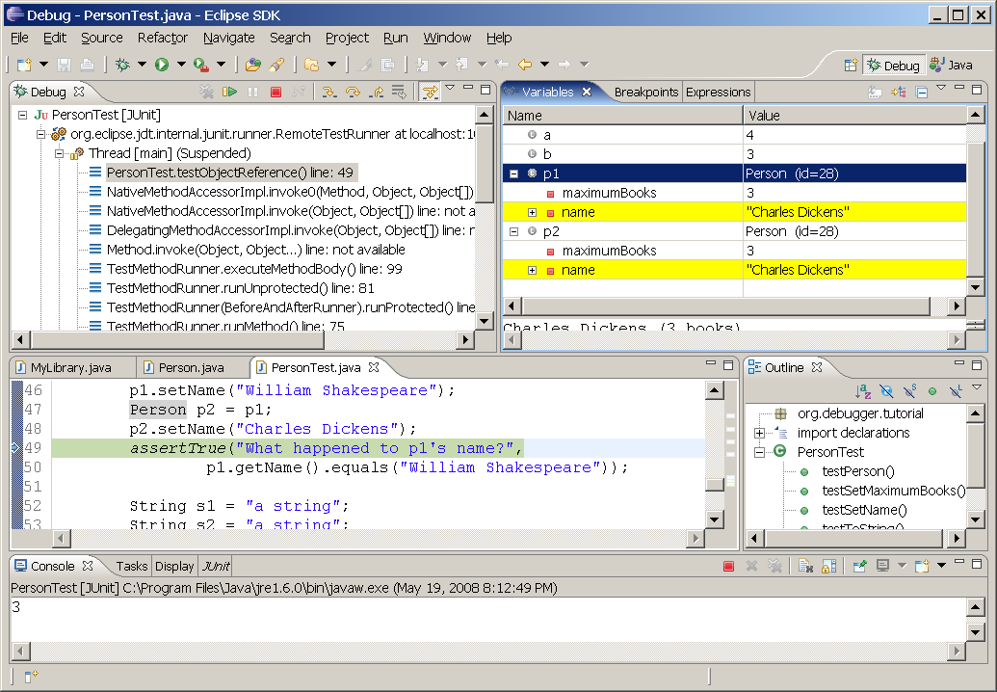
Test Object Reference

Slide 34
Debugging into Java Classes
Attaching source code allows us to browse source code but not debug into source code
To debug Java Classes, need special version of Java Runtime Engine (JRE)
This version is included with JDK 1.6
(“C:\Program Files\Java\jdk1.6.0\jre”)
Need to configure Eclipse to use this special JRE
Test method: addBook

Slide 35
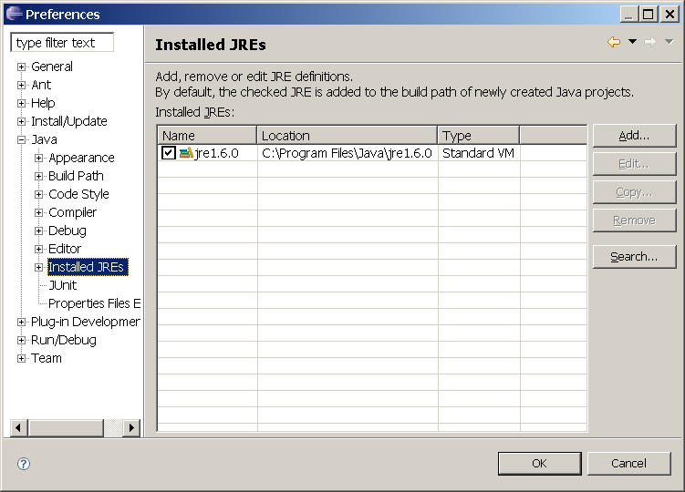
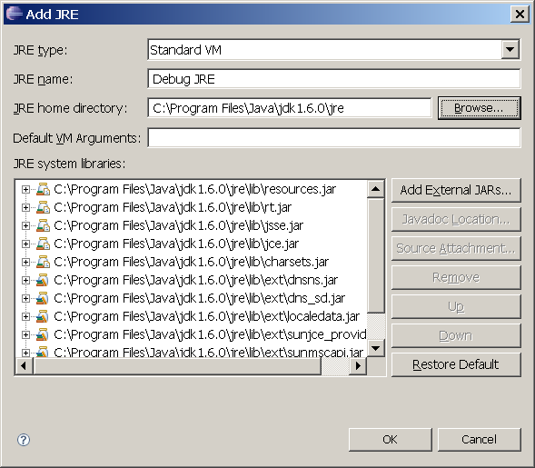
Configure Eclipse

Slide 36
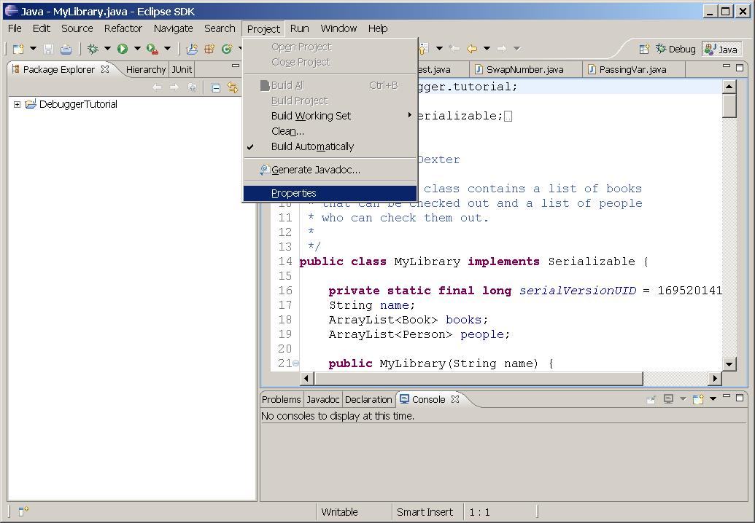
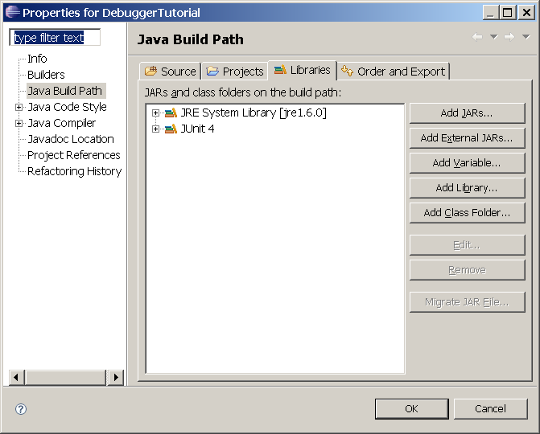
Configure Eclipse

Slide 37
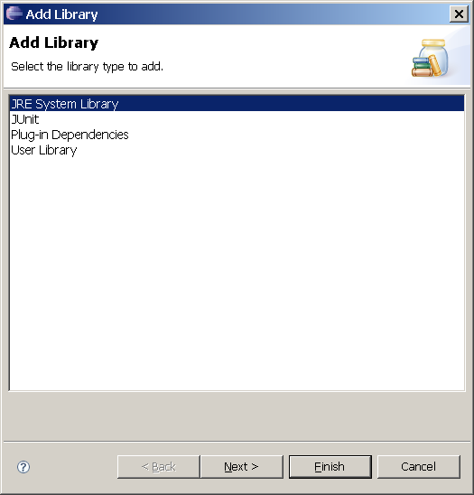
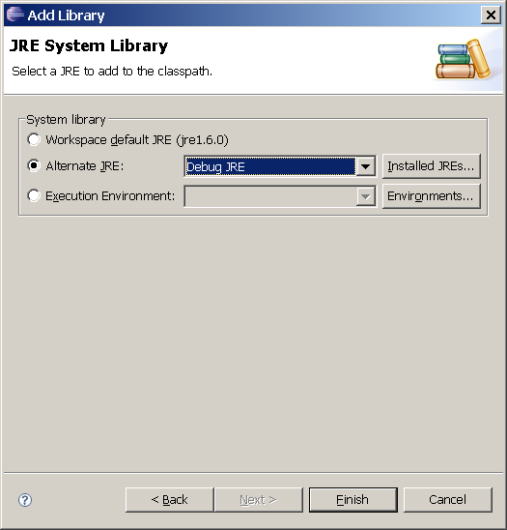
Configure Eclipse

Slide 38
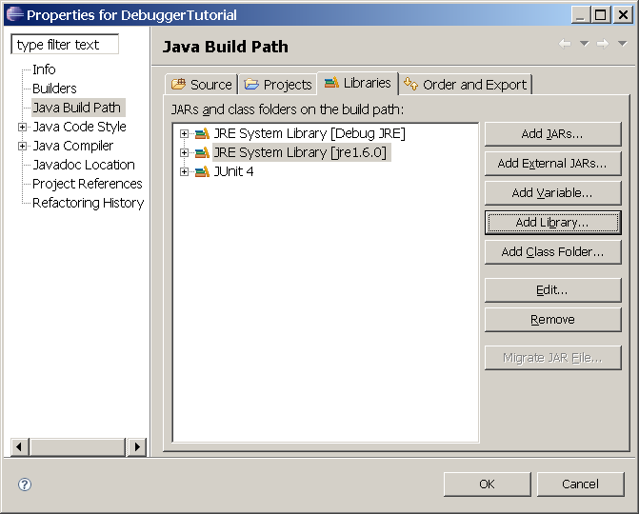
Configure Eclipse

Slide 39
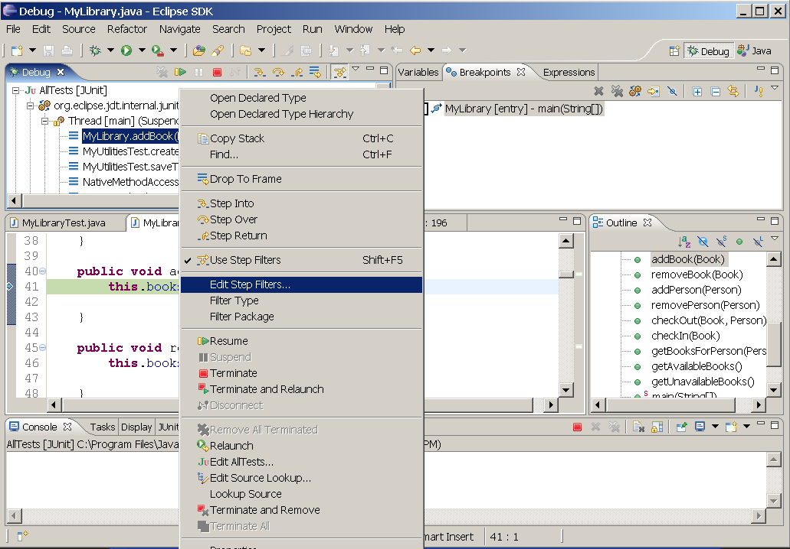
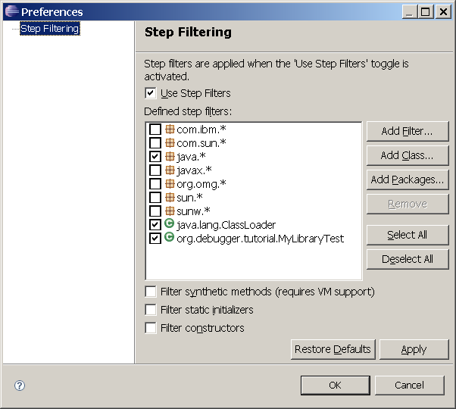
Step Filter

